Slide 1

[Samsung PRISM] End Review Report
[5G MAC control decoders]
Team
College Professor(s): S.Kayalvizhi, Dr. K. Ferents Koni Jiavana
Students:
RESHESH KUMAR PATHAK
KAUSTUV MOHANTY
KINJALK SRIVASTAVA
SUKRATI MADARIYA
Department: ECE
Date: 17 October 2022

Slide 2
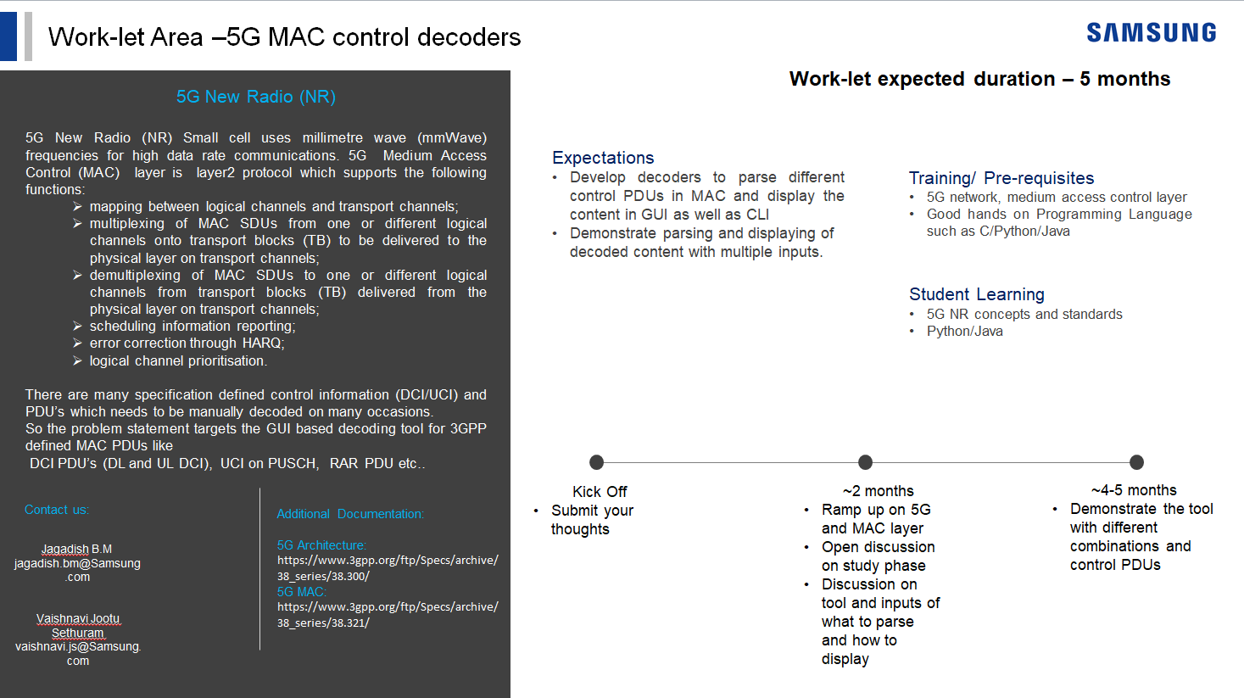
Notes:
-

Slide 3
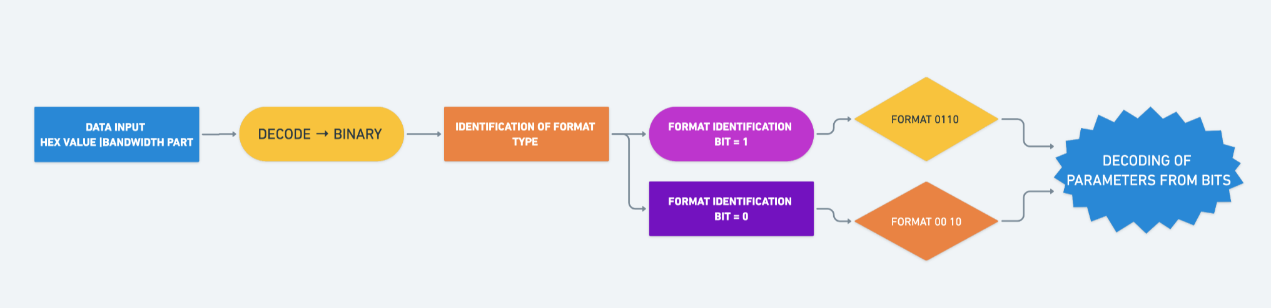
Approach / Solution
Concept Diagram :
( Clear detailed schematic / block diagram / flow chart depicting the proposed concept / solution )
10 11
00 01

Slide 4
Dataset(s) Analysis / Description
Dataset Capture / Preparation / Generation :
(Discuss the dataset generation process or if downloaded data provide details of what data & from where it was obtained etc… - 2 to 3 bullets only)
Get hexadecimal values and bandwidth from user
Convert the hexadecimal value into binary.
Flip the sequence of the binary value and decode.
Dataset Understanding / Analysis :
(Provide 2 to 3 bullets about what is your understanding of the data / opinion about the data)
Data provided has to be converted into binary
The parameters of the DCI formats has to be decoded from the binary values using specific bit lengths
Get the output values of each parameters as per bit lengths.
Dataset Pre-Processing / Related Challenges (if any) :
(List out the challenges you fore see in data handling wrt problem definition – 2 to 3 bullets only)
Many parameters required / had dependency on higher RRC layers
Conversion of hexadecimal to binary and reading of bit order
Conversion of bandwidth to RB to calculate parameters

Slide 5
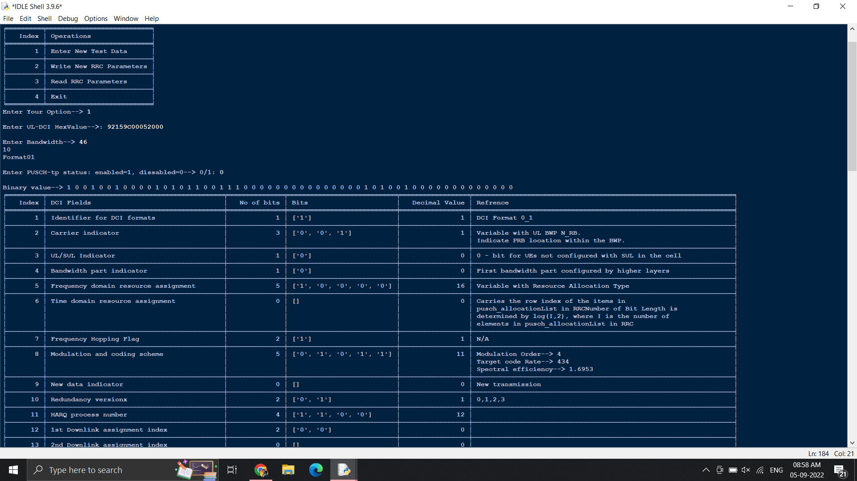
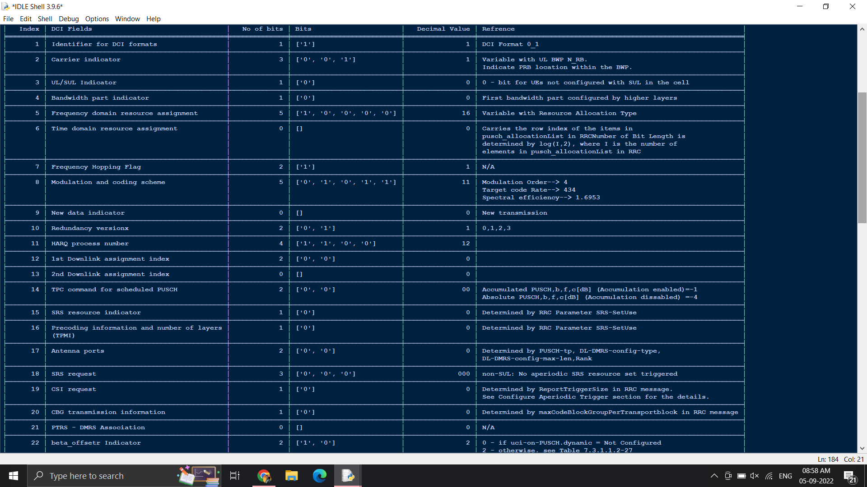
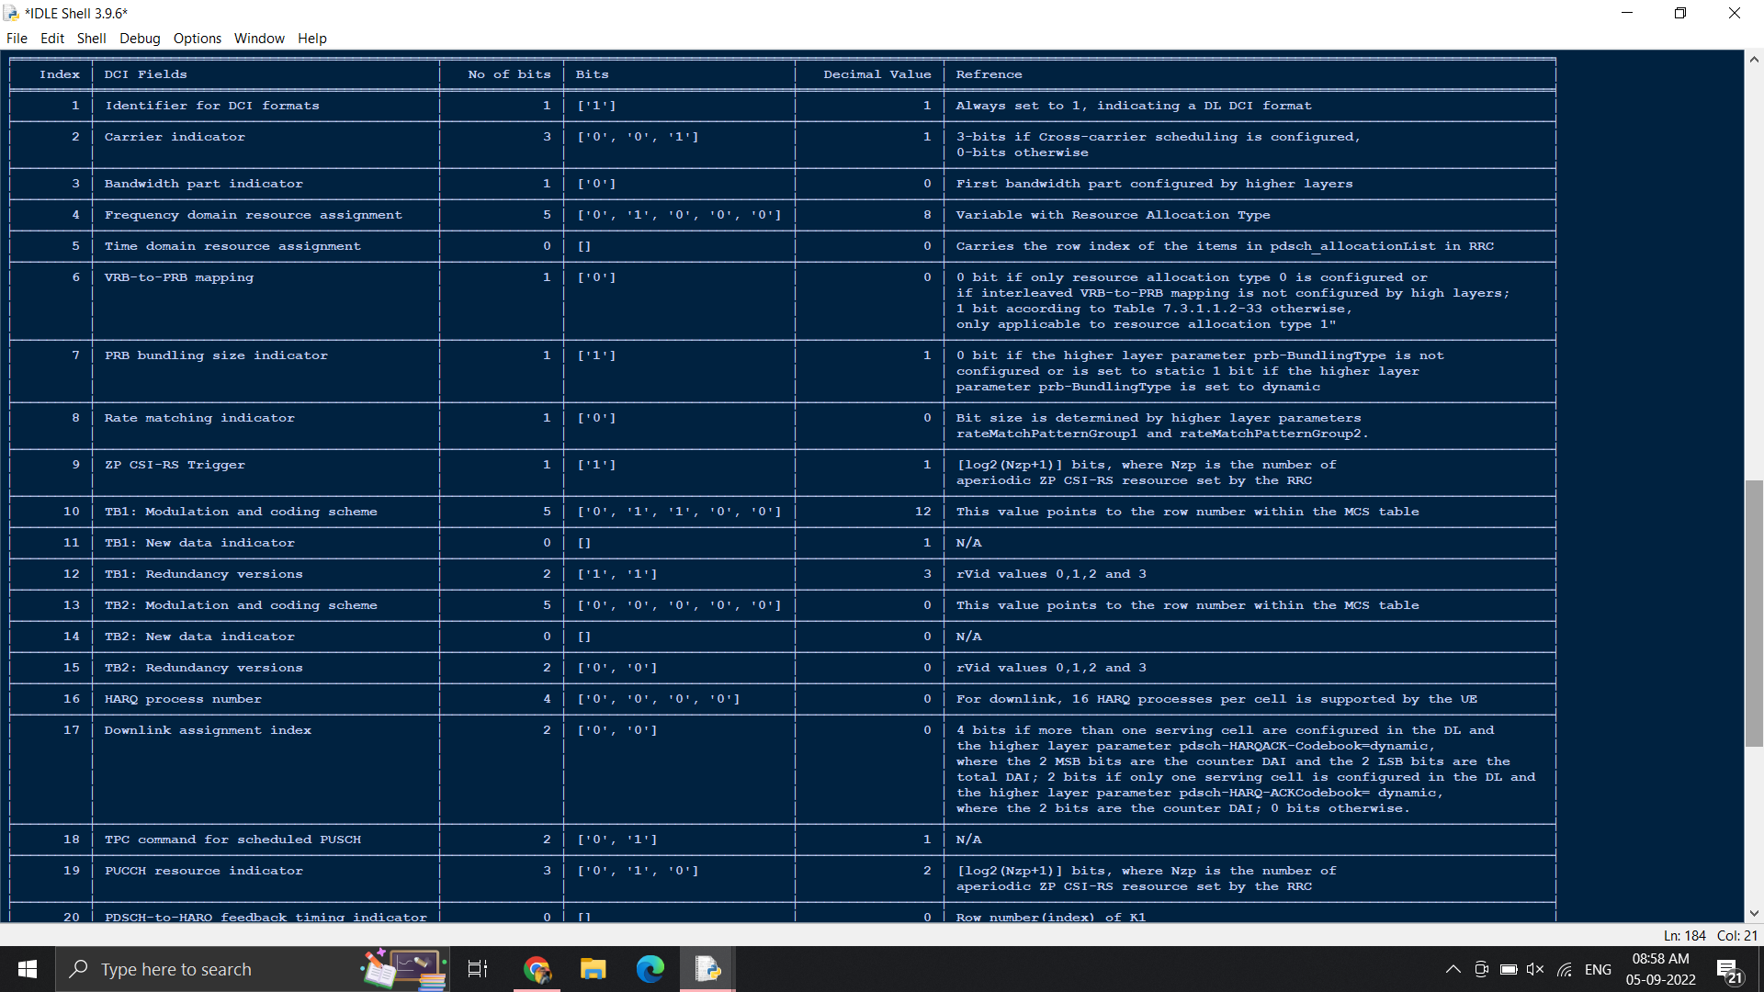
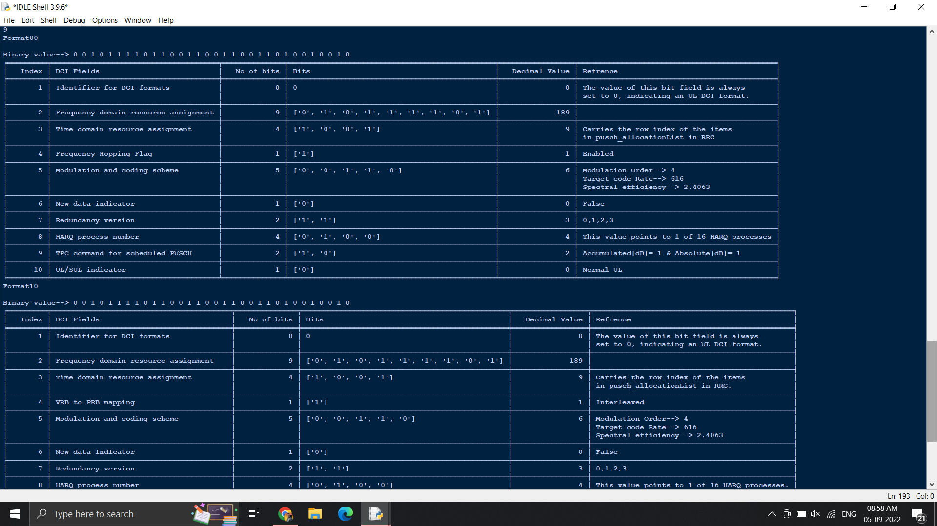
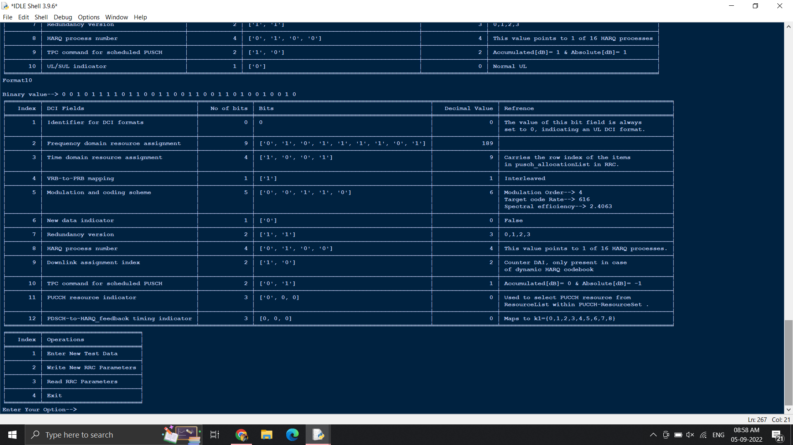
Experimental Results / Simulations / Observations
Results :
(provide numerical data / bar charts / plots / images / videos / tabulated results etc. Use full slide or multiple slides up to max 3 slides to demonstrate the results)

Slide 6
Deliverable
Final Deliverables :
(Discuss in the form of bullets, what are the next steps to complete the solution, any road blocks / bottlenecks, any support needed from SRIB)
Solutions include :
Making the code dynamic to accept variable bit lengths
Reading binary value from LSB to MSB
Conversion from bandwidth to RB to calculate some parameters
Making corrections asked in last review
The team will be taking up an additional initiative of initiating a research paper with the " Develop decoders to parse different control PDUs in MAC and display the content in editor view. " , and approach the required panel to proceed for the same.
Developed a decoder to parse different control PDUs in MAC.
Expected to show the output in GUI form which is not done.
It can display decoded content with multiple inputs.

Slide 7
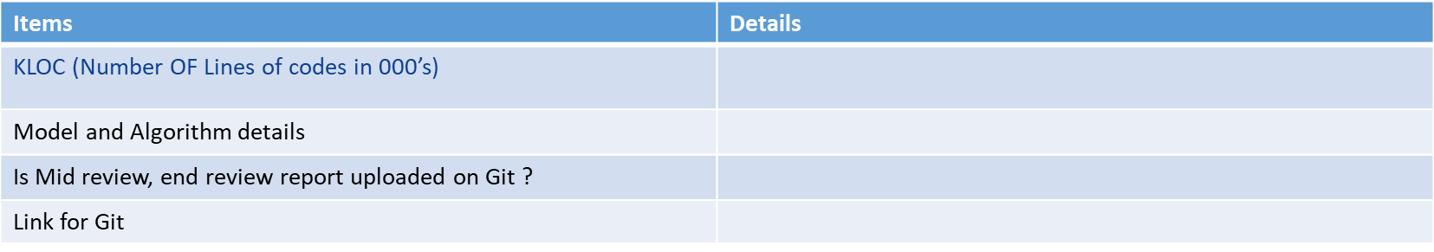
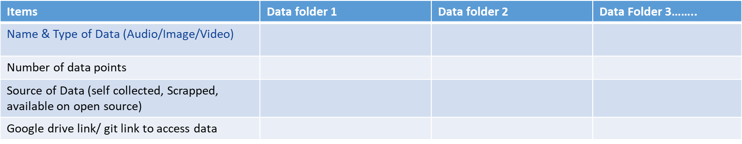
Work-let Closure Details
Code Upload details :
1312
Yes
https://github.ecodesamsung.com/SRIB-PRISM/SRM_AN15SRM_5G_MAC_control_decoders
Data details (if applicable):
DCI hex value - -
2 - -
Self collective - -
- -
Note: If data uploaded on google drive, access to be shared to prism.srib@gmail.com

Slide 8
Thank you

